Slide 1

Slides for Chapter 10:
Peer-to-Peer Systems
From Coulouris, Dollimore, Kindberg and Blair
Distributed Systems:
Concepts and Design
Edition 5, © Addison-Wesley 2012

Slide 2
Figure 10.1: Distinctions between IP and overlay routing for peer-to-peer applications
Instructor’s Guide for Coulouris, Dollimore, Kindberg and Blair, Distributed Systems: Concepts and Design Edn. 5
© Pearson Education 2012

Slide 3
Figure 10.2: Napster: peer-to-peer file sharing with a centralized, replicated index
Instructor’s Guide for Coulouris, Dollimore, Kindberg and Blair, Distributed Systems: Concepts and Design Edn. 5
© Pearson Education 2012

Slide 4
Figure 10.3: Distribution of information in a routing overlay
Instructor’s Guide for Coulouris, Dollimore, Kindberg and Blair, Distributed Systems: Concepts and Design Edn. 5
© Pearson Education 2012

Slide 5
Figure 10.4: Basic programming interface for a distributed hash table (DHT) as implemented by the PAST API over Pastry
put(GUID, data)
The data is stored in replicas at all nodes responsible for the object identified by GUID.
remove(GUID)
Deletes all references to GUID and the associated data.
value = get(GUID)
The data associated with GUID is retrieved from one of the nodes responsible it.
Instructor’s Guide for Coulouris, Dollimore, Kindberg and Blair, Distributed Systems: Concepts and Design Edn. 5
© Pearson Education 2012

Slide 6
Figure 10.5: Basic programming interface for distributed object location and routing (DOLR) as implemented by Tapestry
publish(GUID )
GUID can be computed from the object (or some part of it, e.g. its name). This function makes the node performing a publish operation the host for the object corresponding to GUID.
unpublish(GUID)
Makes the object corresponding to GUID inaccessible.
sendToObj(msg, GUID, [n])
Following the object-oriented paradigm, an invocation message is sent to an object in order to access it. This might be a request to open a TCP connection for data transfer or to return a message containing all or part of the object’s state. The final optional parameter [n], if present, requests the delivery of the same message to n replicas of the object.
Instructor’s Guide for Coulouris, Dollimore, Kindberg and Blair, Distributed Systems: Concepts and Design Edn. 5
© Pearson Education 2012

Slide 7
Figure 10.6: Circular routing alone is correct but inefficient
Based on Rowstron and Druschel [2001]
The dots depict live nodes. The space is considered as circular: node 0 is adjacent to node (2128-1). The diagram illustrates the routing of a message from node 65A1FC to D46A1C using leaf set information alone, assuming leaf sets of size 8 (l = 4). This is a degenerate type of routing that would scale very poorly; it is not used in practice.
Instructor’s Guide for Coulouris, Dollimore, Kindberg and Blair, Distributed Systems: Concepts and Design Edn. 5
© Pearson Education 2012

Slide 8
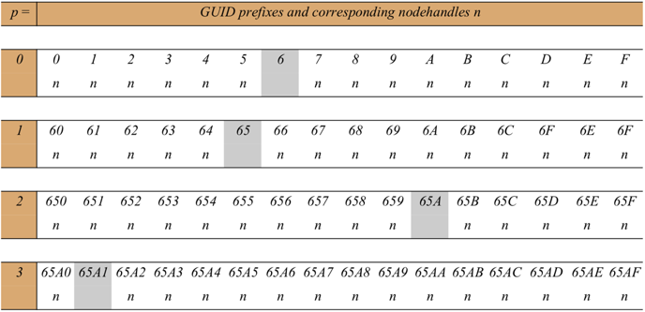
Figure 10.7: First four rows of a Pastry routing table
The routing table is located at a node whose GUID begins 65A1. Digits are in hexadecimal. The n’s represent [GUID, IP address] pairs specifying the next hop to be taken by messages addressed to GUIDs that match each given prefix. Grey- shaded entries indicate that the prefix matches the current GUID up to the given value of p: the next row down or the leaf set should be examined to find a route. Although there are a maximum of 128 rows in the table, only log16 N rows will be populated on average in a network with N active nodes.
Instructor’s Guide for Coulouris, Dollimore, Kindberg and Blair, Distributed Systems: Concepts and Design Edn. 5
© Pearson Education 2012

Slide 9
Figure 10.8: Pastry routing example Based on Rowstron and Druschel [2001]
Instructor’s Guide for Coulouris, Dollimore, Kindberg and Blair, Distributed Systems: Concepts and Design Edn. 5
© Pearson Education 2012

Slide 10
Figure 10.9: Pastry’s routing algorithm
Instructor’s Guide for Coulouris, Dollimore, Kindberg and Blair, Distributed Systems: Concepts and Design Edn. 5
© Pearson Education 2012

Slide 11
Figure 10.10: Tapestry routing From [Zhao et al. 2004]
Instructor’s Guide for Coulouris, Dollimore, Kindberg and Blair, Distributed Systems: Concepts and Design Edn. 5
© Pearson Education 2012

Slide 12
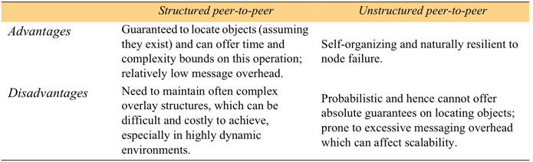
Figure 10.11: Structured versus unstructured peer-to-peer systems
Instructor’s Guide for Coulouris, Dollimore, Kindberg and Blair, Distributed Systems: Concepts and Design Edn. 5
© Pearson Education 2012

Slide 13
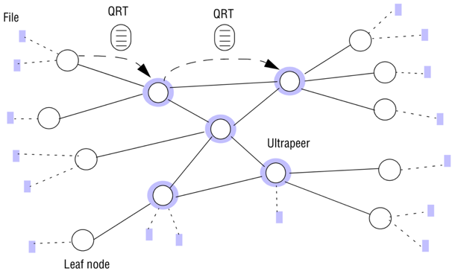
Figure 10.12: Key elements in the Gnutella protocol
Instructor’s Guide for Coulouris, Dollimore, Kindberg and Blair, Distributed Systems: Concepts and Design Edn. 5
© Pearson Education 2012

Slide 14
Figure 10.13: Storage organization of OceanStore objects
AGUID
certificate
VGUID of current
version
version i+1
VGUID of
version i
d1
d2
d3
BGUID (copy on write)
root block
version i
indirection blocks
data blocks
d1
d2
d3
d4
d5
VGUID of version i-1
Instructor’s Guide for Coulouris, Dollimore, Kindberg and Blair, Distributed Systems: Concepts and Design Edn. 5
© Pearson Education 2012

Slide 15
Figure 10.14: Types of identifier used in OceanStore
Name
Meaning
Description
BGUID
block GUID
Secure hash of a data block
VGUID
version GUID
BGUID of the root block of a version
AGUID
active GUID
Uniquely identifies all the versions of an object
Instructor’s Guide for Coulouris, Dollimore, Kindberg and Blair, Distributed Systems: Concepts and Design Edn. 5
© Pearson Education 2012

Slide 16
Figure 10.15: Performance evaluation of the Pond prototype emulating NFS
LAN
WAN
Predominant
operations in
Phase
Linux NFS
Pond
Linux NFS
Pond
benchmark
1
0.0
1.9
0.9
2.8
Read and write
2
0.3
11.0
9.4
16.8
Read and write
3
1.1
1.8
8.3
1.8
Read
4
0.5
1.5
6.9
1.5
Read
5
2.6
21.0
21.5
32.0
Read and write
Total
4.5
37.2
47.0
54.9
Instructor’s Guide for Coulouris, Dollimore, Kindberg and Blair, Distributed Systems: Concepts and Design Edn. 5
© Pearson Education 2012

Slide 17
Figure 10.16: Ivy system architecture
Instructor’s Guide for Coulouris, Dollimore, Kindberg and Blair, Distributed Systems: Concepts and Design Edn. 5
© Pearson Education 2012

